Slide 1
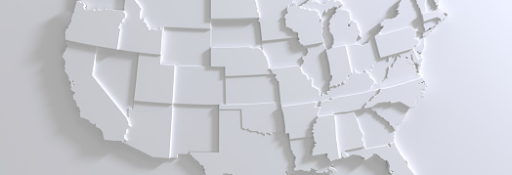
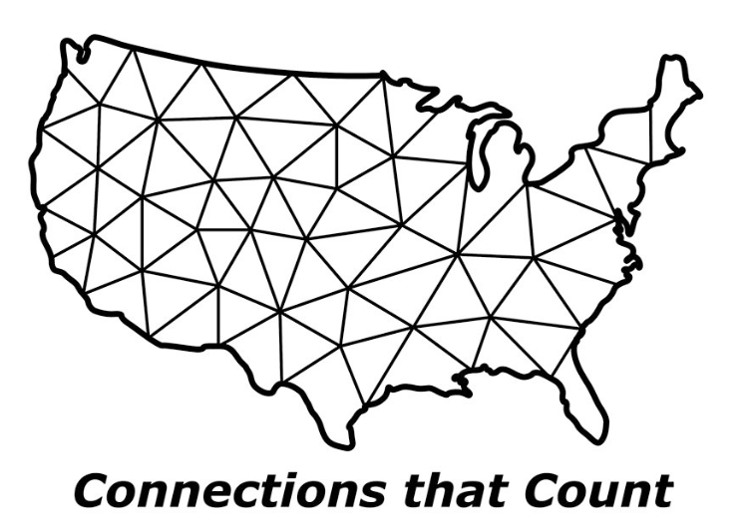

Working with State Attorneys General Why should companies care?

Slide 2
State AGs: Who are they? What is their authority?
AGs are the states’ chief legal officer
AGs are popularly elected in 43 states and the District of Columbia (appointed by Supreme Court in TN, and by governor in AK, HI, NH, NJ and WY; elected by legislature in ME).
Duties include:
Litigation on behalf of state agencies and institutions
Prosecutions on behalf of state consumers
Legal advice to governor and legislature
Affirmative litigation
(e.g., consumer protection, antitrust, environmental)
Enforcement of federal laws (e.g., HIPAA, COPPA, GLBA, CPSA, HSR)
Criminal appeals, and in some instances, prosecutions
Issuing formal legal opinions

Slide 3
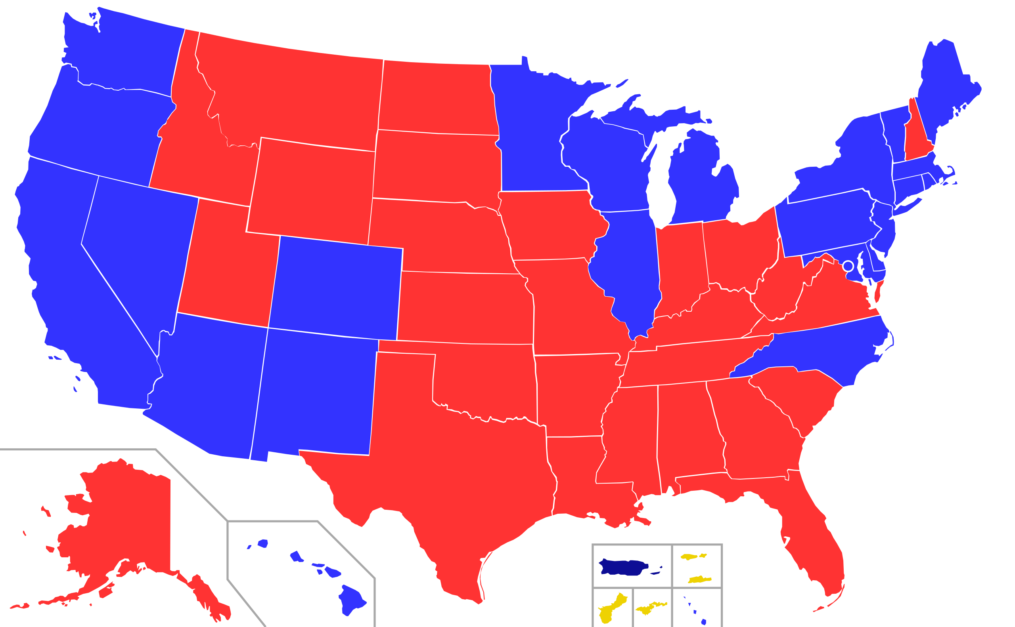
Current political composition
23
28
DEM
GOP

Slide 4


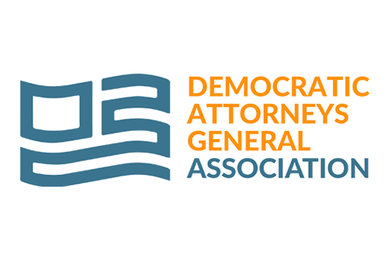
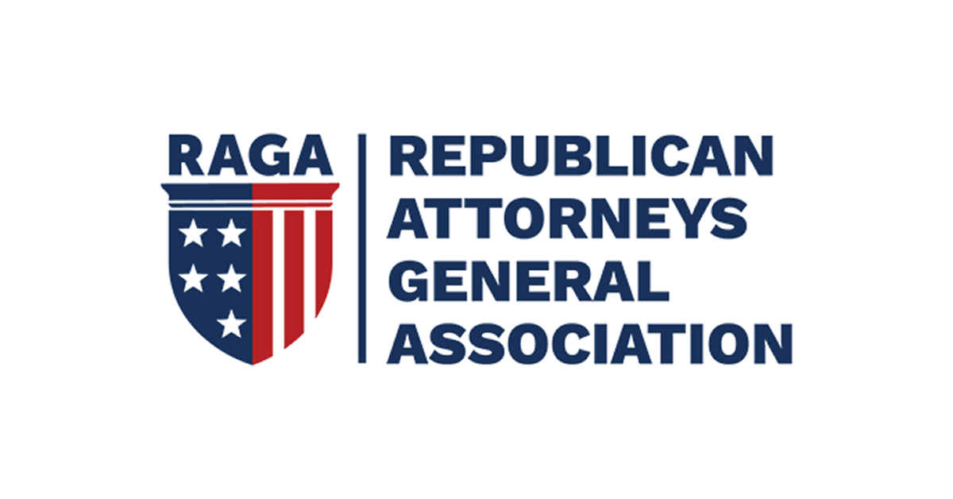
National AG organizations
AGs often coordinate their activities through national AG organizations, each of which meets several times each year
National Association of Attorneys General (NAAG)
Facilitates cooperation among the AGs
Serves as a clearinghouse for multistate initiatives, amicus briefs and sign-on letters
Partisan organizations:
Democratic Attorneys General Association (DAGA)
Republican Attorneys General Association (RAGA)
Attorney General Alliance (AGA): Originally focused on western issues, now comprised of 30+ AGs from across the U.S.

Slide 5

AG trends
Aspiration for political office
Elected AGs view themselves as consumer champions and are very responsive to current issues and news trends
AGs commonly strive to go on to higher offices and seek publicity and high-profile achievements
Former AGs include former President Bill Clinton, former Vice President Kamala Harris, and numerous governors and U.S. Senators
AG policy and National opioids litigation
Major catalysts: 1999 $368 billion Tobacco Settlement and perceived federal regulatory void.
Other key areas of AG activities:
Traditional Consumer Protection (deceptive marketing, false advertising, data breach)
Policy-Making Consumer Protection (tobacco, pharmaceutical suits, national mortgage settlement, for-profit schools, patent trolls)
Antitrust (Microsoft, so-called “pay-for-delay” pharmaceutical cases)
Public Nuisance (prescription drug abuse, lead paint, environmental damage cases)
Securities (Wall Street analysts and mutual funds enforcement actions, high-speed trading)
State False Claims Statutes/qui tam cases
Office funding through penalties or “legal fees” obtained in settlement
With states under intense budget pressures, AG offices increasingly are funded from recoveries and penalties
Multistate activity
Trend of AGs combining resources to tackle large companies or industries (e.g., tobacco, pharmaceuticals, data breach)
States form ad hoc task forces to investigate and litigate
Resolutions can be informal or formal, involving “agreement,” AVCs, consent decrees or litigated judgments
Result is AGs become de facto “national” regulators

Slide 6

Trends in AG activism
Experimentation with Novel Liability Theories
Collaboration Between AGs and Plaintiffs’ Bar
AGs often are solicited by plaintiffs’ lawyers either to bring cases for a share of a recovery or to bring state claims to buttress private suits
Legislatures have attempted to impose transparency, but practice is appealing to AGs with limited resources
Increased State Enforcement of Federal Laws
Financial services with CFPA; data protection of PHI with HIPAA/HITECH; product safety with CPSA; child privacy protection under COPPA
Increased co-enforcement with federal regulators (e.g., US DOJ, FTC, CFPB)
Increasing matters of state AG activity
Legislation filed by localities (driven by litigation funders and the localities)

Slide 7
Key State AG Issues: Bipartisan
Municipal /Native American tribe litigation
Tech-related issues:
Data privacy (including health privacy)
Cybersecurity
AI and Algorithms (e.g., “dark patterns”)
“Big Tech” dominance
Use of trial lawyers to supplement staff resources
Opioids and fentanyl
Drug pricing
Antitrust enforcement (particularly vis-à-vis “Big Tech”)
Consumer protection (e.g., scams, price gouging)
False claims acts enforcement
Supply chain issues
Healthcare-related mergers
7
Working with State Attorneys General

Slide 8
Key State AG Issues: Partisan (Often Highly-Charged)
ESG and DEI issues (e.g., climate change, environmental justice, social justice)
Immigration/border security
Reproductive rights/abortion medication
Second Amendment issues
COVID-19 and vaccine issues
Voting rights, redistricting, election integrity
Federal regulation and enforcement
Corporations increasing asked to “pick sides” on major issues
Multistate investigations and litigations by partisan groups
8
Working with State Attorneys General

Slide 9
How best to work with AGs
Benefits of Working Proactively with AGs
Companies devote substantial resources to federal/state legislative activities; AGs unquestionably are an important force and deserve attention
Working with state AGs can help a company avoid becoming a target and help manage issues before “headlines” or litigation arise; can also help companies achieve affirmative policy goals
Even if a company becomes a target, working with AGs can help limit issues and facilitate solutions
Relationships established with AGs can yield benefits as AGs move into other offices

Slide 10

